Slide 1
Business Intelligence and Business Analytics (H9BIBA)

Slide 2
Credits
Data Mining: Concepts and Techniques
J. Han & M. Kamber, Morgan Kaufmann, 2nd Edition, 2006.
Introduction to Data Mining
P-N Tan, M. Steinbach & V. Kumar, Addison Wesley, 2006.
Data Mining: A Tutorial-Based Primer
R. Roiger & M.W. Geatz, Addison Wesley, 2003.
Advances in Data Mining: Theoretical Aspects and Applications
Petra Pertner (Ed.), July 2007.
Data Mining: Concepts, Models, Methods, and Algorithms
M. Kantardzic, Wiley-International, 2001.
Discovering Knowledge in Data: An introduction to Data Mining
D.T. Larose, Wiley, 2005.

Slide 3
Module Content
Intelligent Enterprises
Agile Enterprises, Operating Strategies, Continuous Improvement Programs
Enterprise Systems
Evolution – MRP, CL MRP, MRP II, ERP, ES Packages, Balanced Scorecard
BI and Dashboards
Views v Reports, Types of Dashboards, Advantages of Dashboards, The Funnel
Consumer Behaviour models
Behaviourist v Cognitivist, Lawson’s, EKB, and Howard and Sheth’s models
Operational CRM Systems
Overview and Demo of a commercial system such as Microsoft Dynamics CRM
Implementing Enterprise BI systems
Data Warehousing and Data Marts, Data mining, Online Analytical Process (OLAP)
Implementing CRM systems
Fit-Gap Analysis, Integration with Heterogeneous systems, Data integration, Information Lifecycle Management, Data protection, security and ethical considerations
Customer-Centric Enterprise with CRM
Customer Experience, Customer Loyalty, Customer Relationships, Customer Life Cycle, Customer Value Management
Customer-Responsive Enterprise with SCM
Supply Chain Management, Customer-Responsive Management, B-Webs, Activity Costing techniques
Renewing Enterprise with PLM
Components and Advantages of PLM, Porter’s Framework, Product Life Cycle
Collaborative Enterprise with BPM
BPM, BPR, Business Processes with SOA, Workflows, Analytics
Informed Enterprise with BI
Context-Aware Applications, Decision Patterns and Data mining

Slide 4
Today
Implementing Enterprise BI systems
Data Warehousing and Data Marts, Data mining, Online Analytical Process (OLAP)

Slide 5
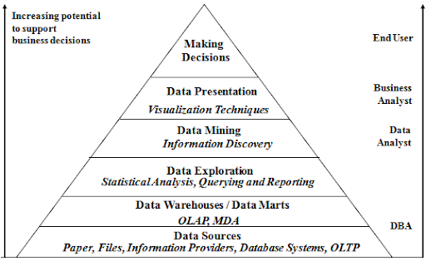
Business Intelligence

Slide 6

Data Warehousing

Slide 7
Learning Outcomes
Define data warehouse.
Difference between data warehouse & DB.
Concepts OLAP & OLTP.
Why separate data warehouse ?

Slide 8
What is Data Warehouse?
Defined in many different ways, but not rigorously
A decision support database that is maintained separately from the organization's operational database.
Support information processing by providing a solid platform of consolidated, historical data for analysis.
Definition by Inmon
“A data warehouse is a subject-oriented, integrated, time-variant, and non-volatile collection of data in support of management’s decision-making process”.
Data warehousing
The process of constructing and using data warehouses.

Slide 9
Data Warehouse—Subject-Oriented
Organized around major subjects, such as customer, product, sales.
Focusing on the modelling and analysis of data for decision makers, not on daily operations or transaction processing.
Provide a simple and concise view around particular subject issues by excluding data that are not useful in the decision support process.

Slide 10
Data Warehouse—Integrated
Constructed by integrating multiple, heterogeneous data sources
relational databases, flat files, on-line transaction records.
Data cleaning and data integration techniques are applied
Ensure consistency in naming conventions, encoding structures, attribute measures, etc. among different data sources.
E.g., Hotel price: currency, tax, breakfast covered, etc.
When data is moved to the warehouse, it is converted.

Slide 11
Data Warehouse—Time Variant
The time horizon for the data warehouse is significantly longer than that of operational systems.
Operational database: current value data.
Data warehouse data: provide information from a historical perspective (e.g., past 5-10 years).
Every key structure in the data warehouse
Contains an element of time, explicitly or implicitly.
But the key of operational data may or may not contain “time element”.

Slide 12
Data Warehouse—Non-Volatile
Physically separate stores of data transformed from the operational environment.
Operational update of data does not occur in the data warehouse environment
Does not require transaction processing, recovery, and concurrency control mechanisms.
Requires only two operations in data accessing: initial loading of data and access of data.

Slide 13
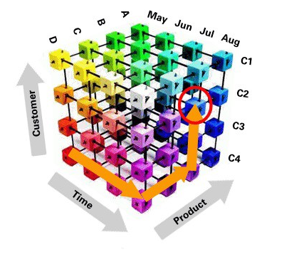
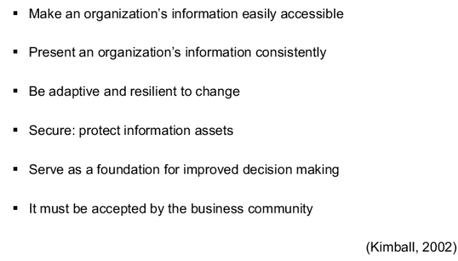
Data Warehouse Requirements

Slide 14
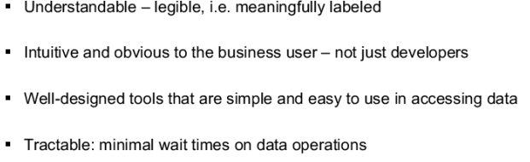
Data Warehouse Requirements: Accessibility

Slide 15
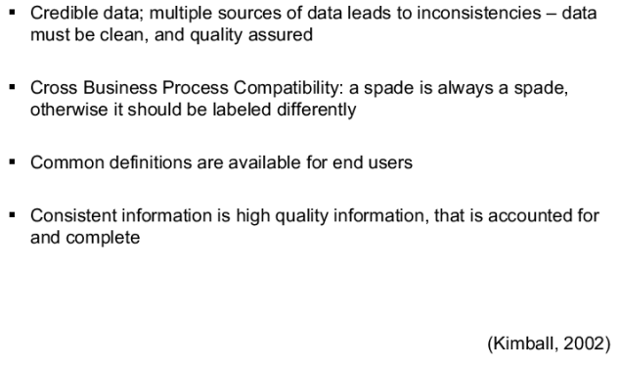
Data Warehouse Requirements: Consistency

Slide 16
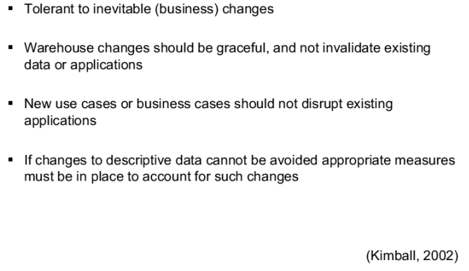
Data Warehouse Requirements: Adaptive and Resilient

Slide 17
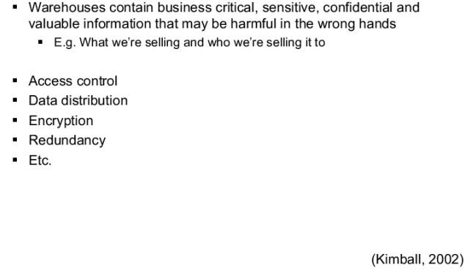
Data Warehouse Requirements: Secure

Slide 18
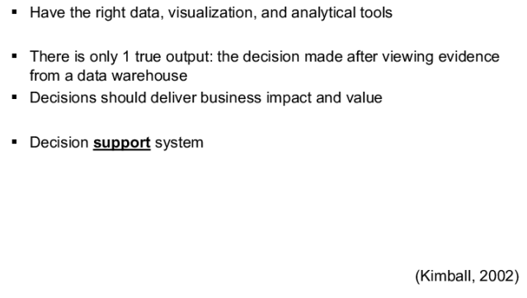
Data Warehouse Requirements: Improved Decision Making

Slide 19
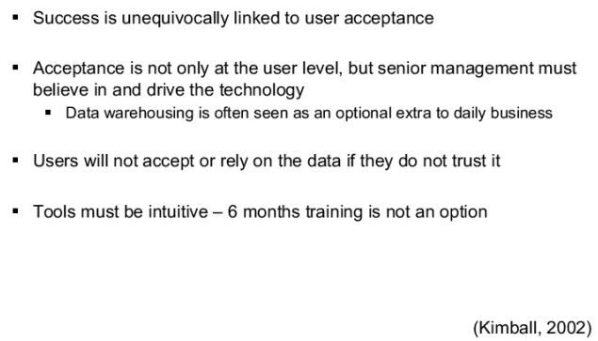
Data Warehouse Requirements: Acceptability

Slide 20
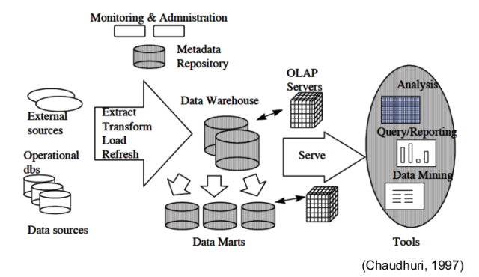
Basic Architecture of a Data Warehouse

Slide 21
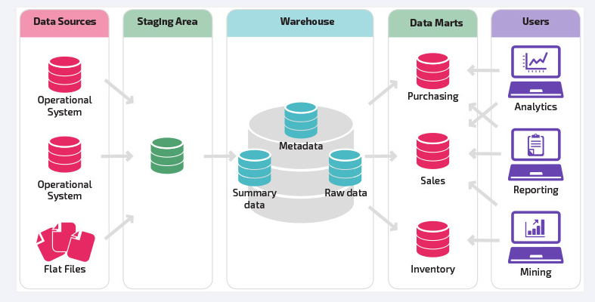
Basic Architecture of a Data Warehouse
https://panoply.io/data-warehouse-guide/data-warehouse-architecture-traditional-vs-cloud/
Notes:
https://panoply.io/data-warehouse-guide/data-warehouse-architecture-traditional-vs-cloud/

Slide 22
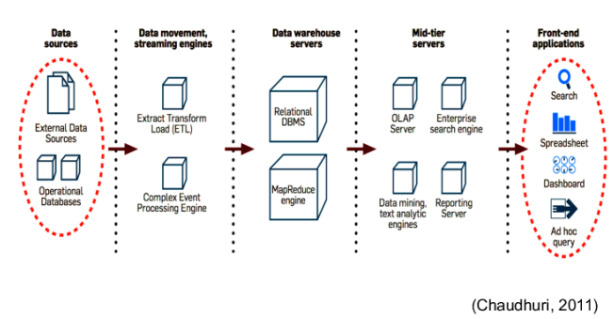
BI Architecture with DW

Slide 23
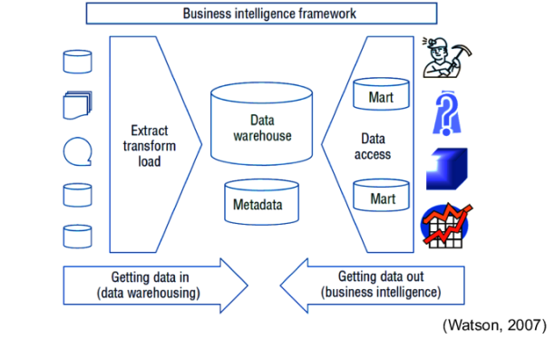
Business Intelligence Framework

Slide 24
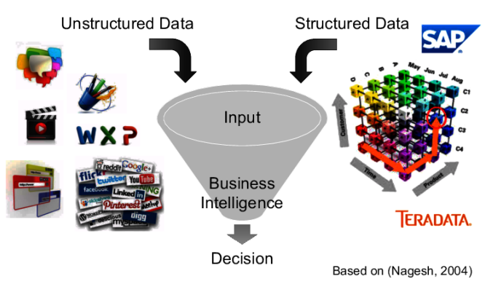
Conceptual Architecture of BI

Slide 25
Data Warehouse vs. Heterogeneous DB
Traditional heterogeneous DB integration
Build wrappers/mediators on top of heterogeneous databases.
Query driven approach.
When a query is posed to a client site, a meta-dictionary is used to translate the query into queries appropriate for individual heterogeneous sites involved, and the results are integrated into a global answer set.
Complex information filtering, compete for resources.
Data warehouse
update-driven, high performance.
Information from heterogeneous sources is integrated in advance and stored in warehouses for direct access and analysis.

Slide 26
Data Warehouse vs. Operational DB
OLTP (On-Line Transaction Processing)
Major task of traditional relational DB.
Day-to-day operations: purchasing, inventory, banking, manufacturing, payroll, registration, accounting, etc.
OLAP (On-Line Analytical Processing)
Major task of data warehouse system.
Data analysis and decision making.
Distinct features (OLTP vs. OLAP)
User and system orientation: customer vs. market.
Data contents: current, detailed vs. historical, consolidated.
Database design: ER + application vs. star + subject.
View: current, local vs. evolutionary, integrated.
Access patterns: update vs. read-only but complex queries.

Slide 27
OLTP vs. OLAP
Parameters | OLTP | OLAP
User type | It is used by Data critical users like clerk, DBA & Data Base professionals. | Used by Data knowledge users like workers, managers, and CEO.
Function | Day to day operations. | Decision support.
Design | DB design is application oriented. Example: Database design changes with industry like Retail, Airline, Banking, etc. | DB design is subject oriented. Example: Database design changes with subjects like sales, marketing, purchasing, etc.
Data | Up-to-date. | Historical.
Purpose | Designed for real time business operations. | Designed for analysis of business measures by category and attributes.
Table | Tables in OLTP database are normalized. | Tables in OLAP database are not normalized.

Slide 28
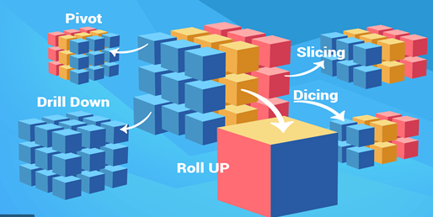
Typical OLAP Operations
Roll up (drill-up): summarize data
by climbing up hierarchy or by dimension reduction.
Drill down (roll down): reverse of roll-up
from higher level summary to lower level summary or detailed data, or introducing new dimensions.
Slice and dice
project and select.

Slide 29
Typical OLAP Operations continue …
Pivot (rotate)
reorient the cube, visualization, 3D to series of 2D planes.
Other operations
drill across: involving (across) more than one fact table.
drill through: through the bottom level of the cube to its back-end relational tables (using SQL).

Slide 30
Why Separate Data Warehouse?
High performance for both systems
DBMS— tuned for OLTP.
access methods, indexing, concurrency control, recovery.
Warehouse—tuned for OLAP
complex OLAP queries, multidimensional view, consolidation.
Different functions and different data
Missing data: Decision support requires historical data which operational DBs do not typically maintain.
Data consolidation: DS requires consolidation (aggregation, summarization) of data from heterogeneous sources.
Data quality: different sources typically use inconsistent data representations, codes and formats which have to be reconciled.

Slide 31
From Tables and Spreadsheets to Data Cubes
A data warehouse is based on
multidimensional data model which views data in the form of a data cube.
A data cube allows data to be modeled and viewed in multiple dimensions (such as sales)
Dimension tables, such as item (item_name, brand, type), or time(day, week, month, quarter, year).
Fact table contains measures (such as Euros_sold) and keys to each of the related dimension tables.
Definitions
an n-Dimensional base cube is called a base cuboid.
The top most 0-D cuboid, which holds the highest-level of summarization, is called the apex cuboid.
The lattice of cuboids forms a data cube.

Slide 32
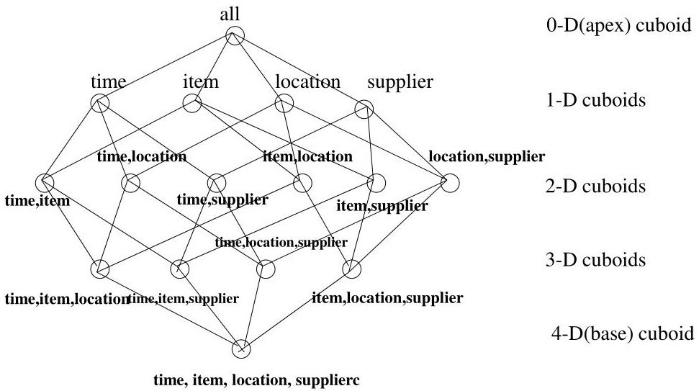
Cube: A Lattice of Cuboids

Slide 33
Conceptual Modeling of Data Warehouses
Modeling data warehouses: dimensions & measures
* Star schema
A fact table in the middle connected to a set of dimension table.
Snowflake schema
A refinement of star schema where some dimensional hierarchy is normalized into a set of smaller dimension tables, forming a shape similar to snowflake.
Fact constellations
Multiple fact tables share dimension tables, viewed as a collection of stars, therefore called galaxy schema or fact constellation.

Slide 34
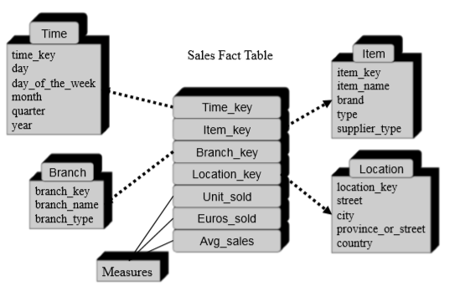
Example of Star schema

Slide 35
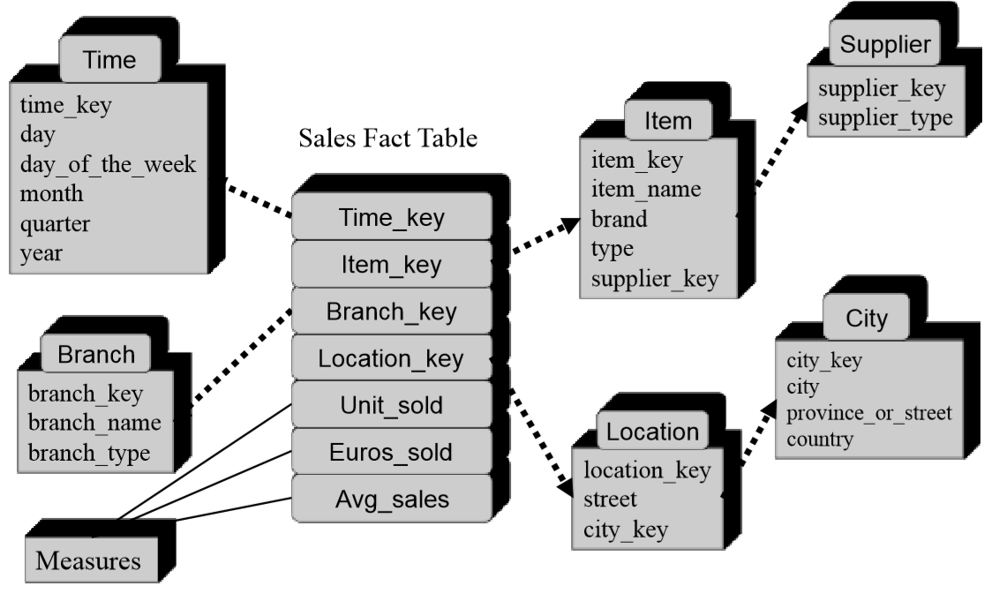
Example of Snowflake Schema

Slide 36
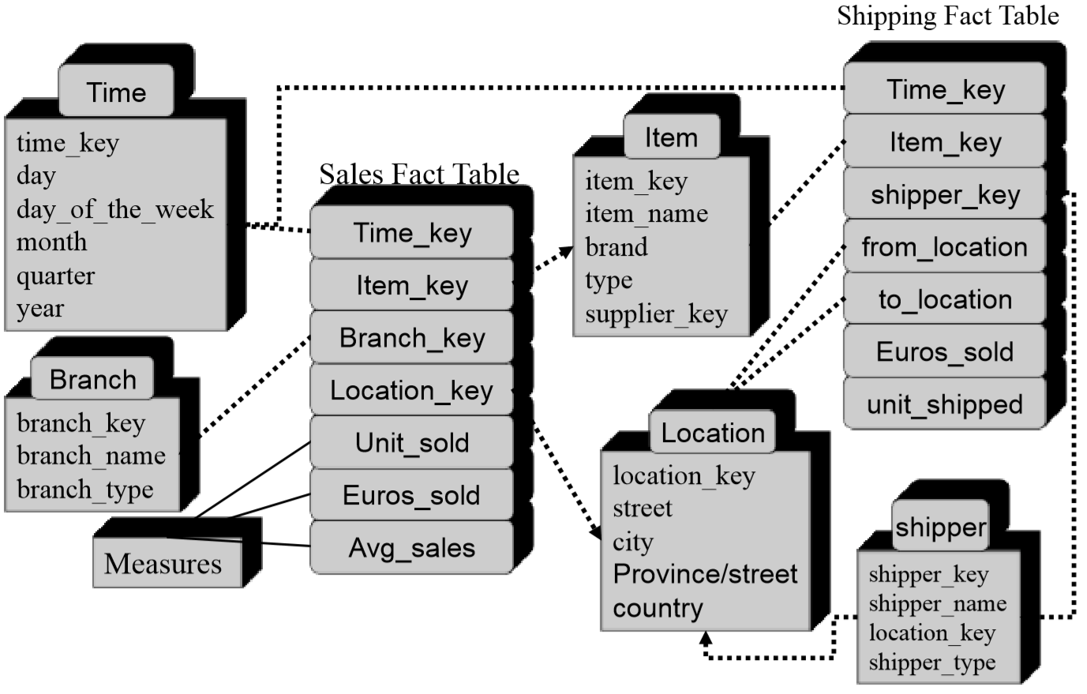
Example of Fact Constellation

Slide 37
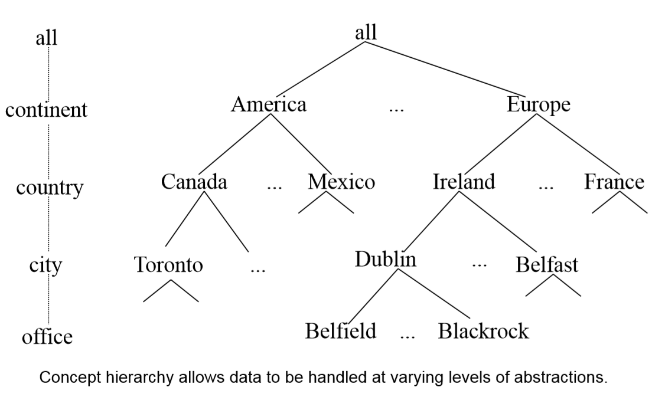
A Concept Hierarchy: Dimension (location)

Slide 38
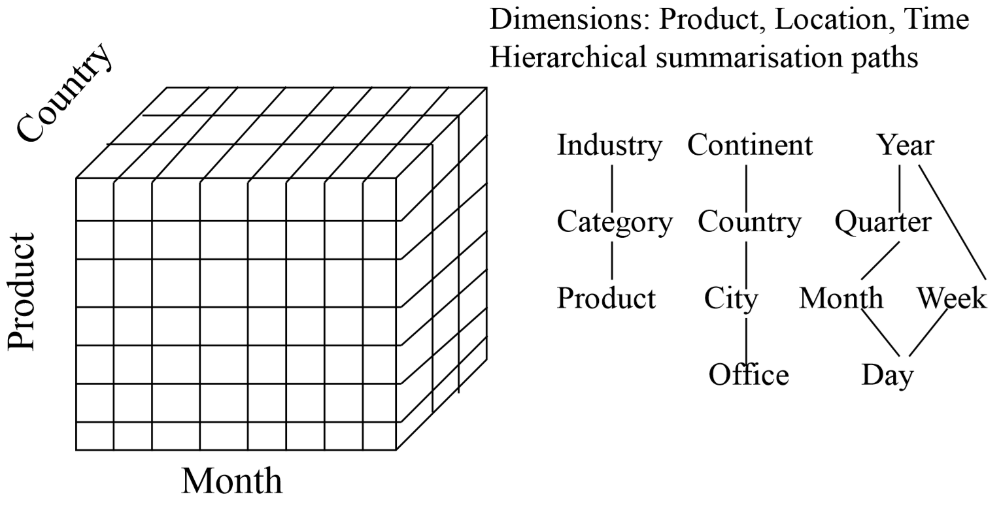
Multidimensional Data
Sales volume as a function of product, month, and Country

Slide 39
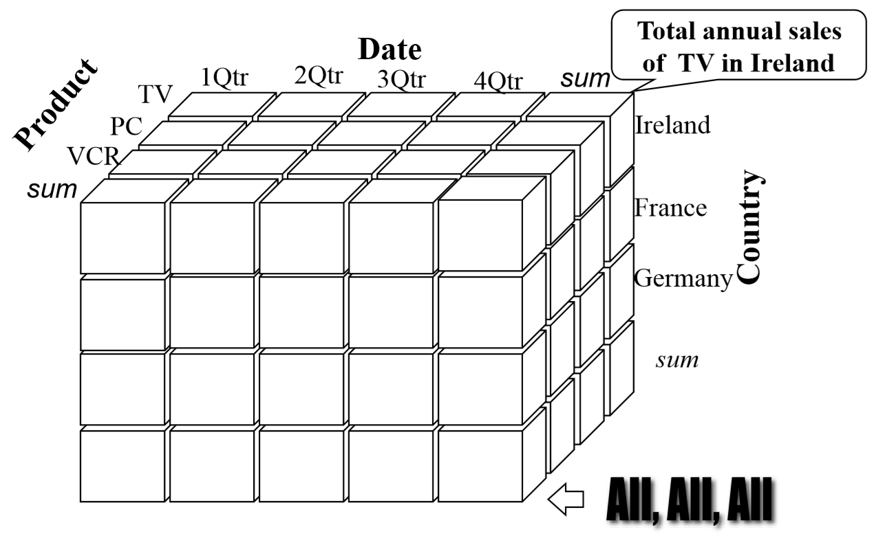
A Sample Data Cube

Slide 40
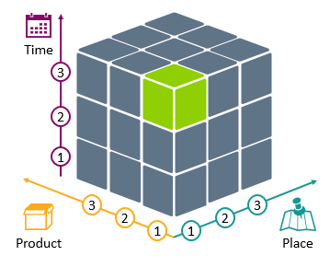
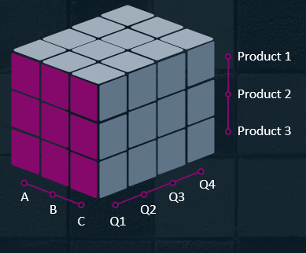
A Sample Data Cube
Notes:
https://blog.infodiagram.com/2019/11/olap-data-cube-presentation-powerpoint.html

Slide 41
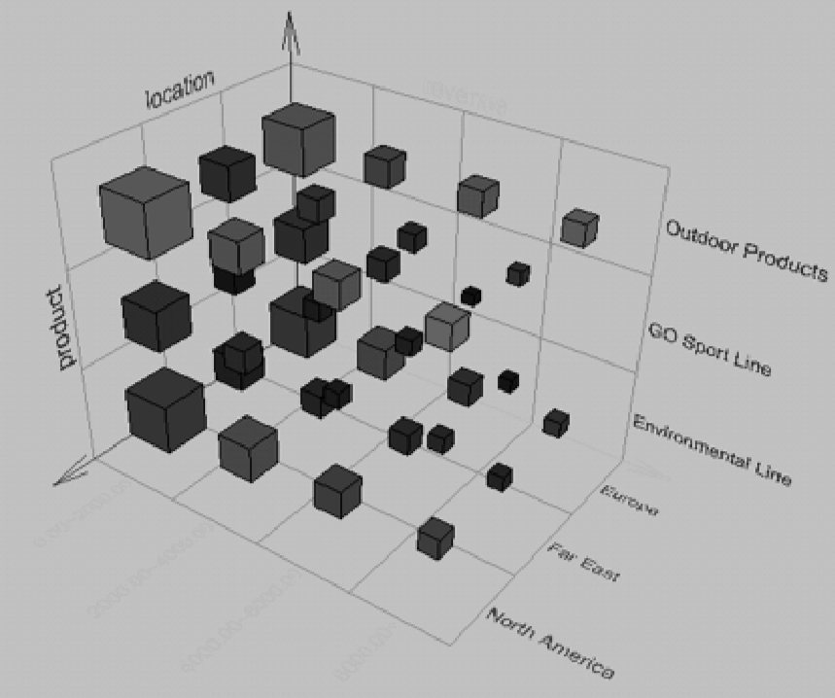
Browsing a Data Cube
Visualisation.
OLAP capabilities.
Interactive manipulation.

Slide 42
Three Data Warehouse Models
Enterprise warehouse
collects all of the information about subjects spanning the entire organisation.
Data Mart
a subset of corporate-wide data that is of value to a specific group of users. Its scope is confined to specific, selected groups, such as marketing data mart.
Independent vs. dependent (directly from warehouse) data mart.
Virtual warehouse
A set of views over operational databases.
Only some of the possible summary views may be materialized.

Slide 43
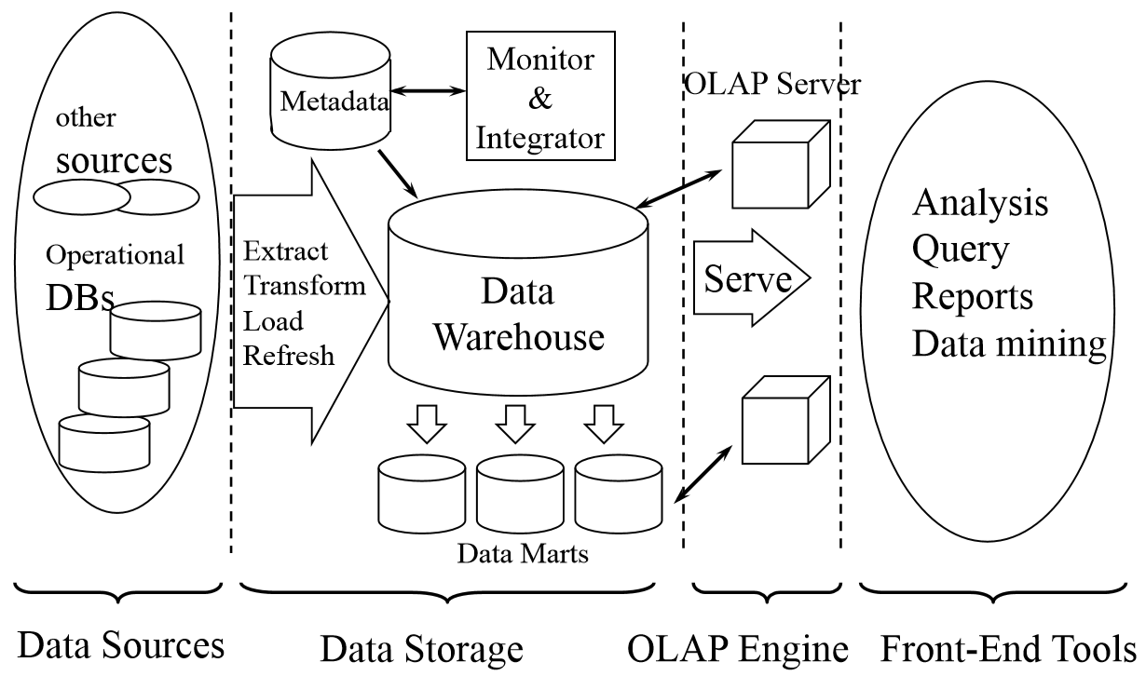
Multi-Tiered Architecture

Slide 44
Further reading
DMQL: Language Primitives.
Data Warehouse Design Process.
OLAP Server Architectures (for advanced implementation).
Data pre-processing.
Descriptive data summarisation.
Association.
Classification.
Clustering.

Slide 45
Useful Links
https://www.guru99.com/data-warehousing-tutorial.html
https://www.guru99.com/data-warehouse-architecture.html https://www.guru99.com/best-siem-tools-software-solutions.html
https://www.splunk.com/en_us/software/enterprise-security.html
https://www.datadoghq.com/
https://www.youtube.com/watch?v=UKCQQwx-Fy4
https://panoply.io/data-warehouse-guide/data-warehouse-architecture-traditional-vs-cloud/
https://blog.infodiagram.com/2019/11/olap-data-cube-presentation-powerpoint.html

